Slide 1

Software Architecture Assignment
“Book-Space”
Explore the book world!

Slide 2
Team - 04
Hima V S 2021SP93052
Hitesh Hiranmaya 2021SP93022
Saksham Gupta 2021SP93044
Tejas K 2021SP93049
Upendra Mallya 2021SP93046

Slide 3

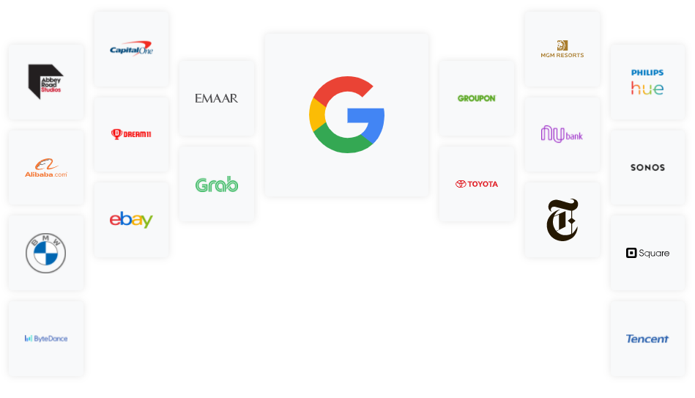
Front End: Flutter
Flutter is an open source framework by Google for building beautiful, natively compiled, multi-platform applications from a single codebase. Flutter is powered by Dart, a language optimized for fast apps on any platform.

Slide 4



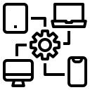

Quality Attributes
Usability
Portability
Performance
Maintainability
Security
Since flutter apps are based on a lot of inbuilt widgets, material UI components it gives the user an option to customize as per their needs.
Same UI and Business Logic in all Platforms thus making it very portable and suitable for most OS.
Flutter has a simple code design and it also has its own rendering engine.
Deploy to multiple devices from a single codebase: mobile, web, desktop, and embedded devices.
Flutter provides time to time security updates of its sdk to keep apps secure, it also has built in authentication plugins.

Slide 5
Technical Risks
Flutter
Larger app size
Lack of third-party libraries
Dart programming language
Long run executions
Rewriting instance state

Slide 6
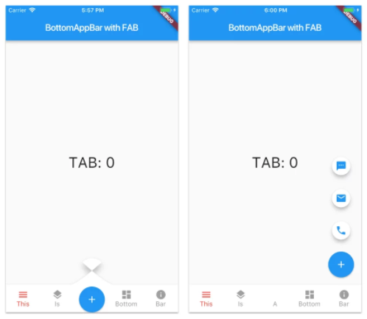
Business Impacts
Low cost App development.
Same UI and Business Logic in All Platforms.
Reduced Code Development Time.
Custom, Animated UI of Any Complexity Available.
Own Rendering Engine.
Minimizes the risks and losses for your business.
Flutter is the quickest way to deliver a well-performing cross-platform mobile application.

Slide 7
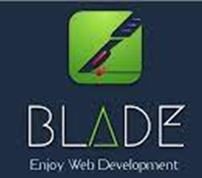
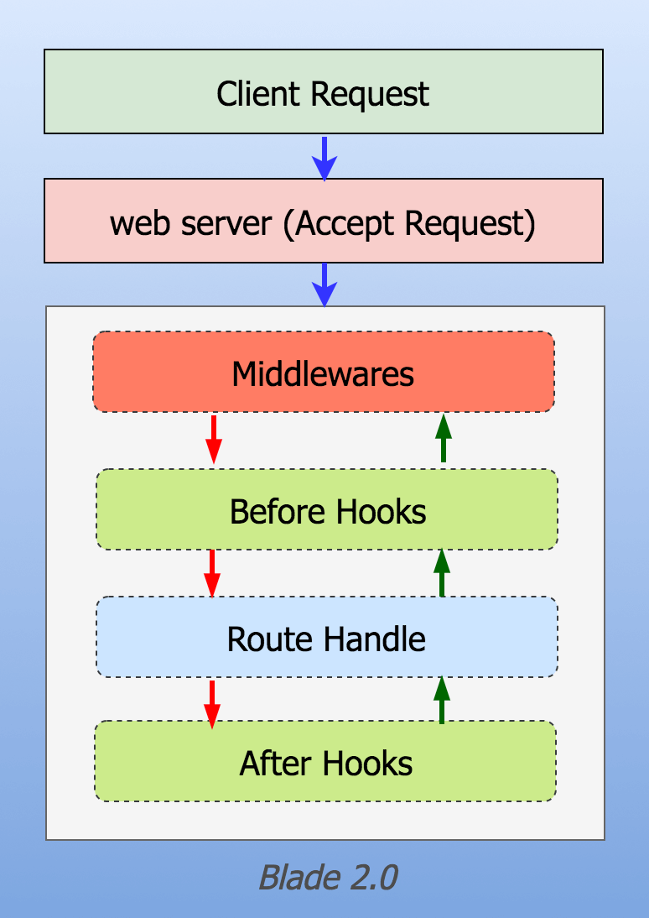
Back End: Java Blade
Blade is a tiny Java 8+ MVC framework, built from scratch with some clear goals in mind: to be self-contained, productive, elegant, intuitive, and super fast.
Many different frameworks inspired its design: Node's Express, Python's Flask, and Golang's Macaron / Martini.
Blade is also part of an ambitiously larger project. It includes a heterogeneous collection of other small libraries, from Captcha generation to JSON conversion, from templating to a simple database connection.

Slide 8


Quality Attributes
Usability
Extensibility
Performance
Security
Modifiability
When writing huge volumes of code, blade keeps the structure fluent and simple for other developers to be able to read it.
Java blade is a versatile framework that supports the plug-in extension mechanism.
Blade is a lightweight framework with embedded web server and template engine support making it much faster in development of applications.
Blade comes with CSRF (Cross-site request forgery) and XSS (Cross-site scripting) defence.
Using the MVC methodology allows easy modification of the entire application.

Slide 9
Business Impacts
Lightweight. The code is simple and structure is clear
Modular (you can choose which components to use)
Multiple configuration files support (currently properties, json and coding)
Embed jetty server and template engine support
Support jdk1.6 or higher version

Slide 10
Technical Risks
There is less community support on java blade and the development is also less active these days.
Scalability is another issue as java blade performance may reduce under higher loads.

Slide 11


Application Demonstration

Slide 12
THANK YOU!

